Slide 1


Protesting Your Property Taxes
How to be Your Own Advocate
Presented by
Gary Rivas, President
SWBC Ad Valorem Tax Advisors
Nikki McNish, Vice President of Operations SWBC Ad Valorem Tax Advisors

Slide 2

San Antonio Market Stats – March 2023
$177
3.2
Months of Inventory
2%
Average Price Per Sq. Ft.
DOM
$366,834
1%
Average Home Price
72
$314,945
100% increase from last year
0%
Median Home Price
$1,815
Average Residential Rental Price

Slide 3


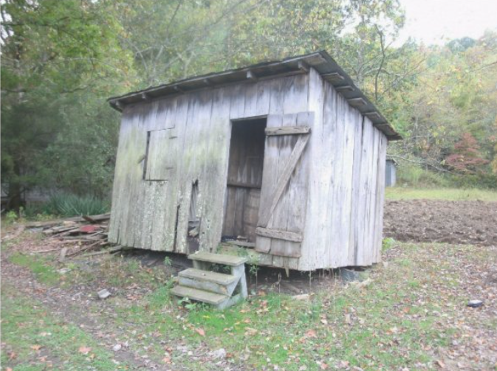
State of Property Taxes
County Appraisals are In…..
Bexar
Comal
Kendall
$360,000
$443,000
$597,000

Slide 4
Home Value Appraisal
January 1
The appraisal district determines your home’s value as of January 1 by calculating the market value of your property based on neighborhood sales and what it could most likely sell for.
1

Slide 5
“Notice of Protest” Deadline
May 15
This is your last day to file a “Notice of Protest” to your appraisal district. For Bexar County’s Appraisal District, visit www.bcad.org.

Slide 6



What is currently in place….
Homestead Exemptions can begin the day you move into your new residence
    Prorated from the day you own and reside in your new home
    The Homestead Cap takes effect on January 1 of the following year the property qualified for the Homestead Exemption (cap will only kick in if the value increases more than 10%)
  Bexar County offered a Homestead Exemption for the first time ever last year
      City of San Antonio increased Exemptible Value on a Homestead
    School District Homestead Exemption is $40,000
    Residence Homestead with an Over 65 or Disabled Exemption can benefit from tax rate compressions
    (It’s a ceiling not a freeze)
Notes:
1% to 10% for Residence Homestead
Over 65 $65,000 to $85,000
Disabled Person Exemption $12,500 to $85,000
$5,000 off the appraised value

Slide 7
What is currently in legislation….
House Bill 2
Reduces the state’s appraisal cap from 10% to 5% and would extend to not only residential but commercial property owners. It would also reduce the school district tax rate by $0.15
Senate Bill 3
Raises homestead exemption from $40,000 to $70,000 and gives homeowners over 65 a $30,000 (up from $10,000. Bringing their total homestead exemption to $100,000.
March 22, 2023 – Passed in the Senate
Senate Bill 4
Provides for additional tax rate compression.
March 22, 2023 – Passed in the Senate
Senate Bill 1923
Prohibits appraisal districts from suing property owners.

Slide 8
Tax Rate Compression
Example based on $300,000 Home Value
ISD | 2021 | 2022 | % Change | Tax Savings
NEISD | 2.554734 | 2.467554 | 3.41% | $261.54
NISD | 2.563534 | 2.475454 | 3.43% | $264.24
SAISD | 2.793834 | 2.709554 | 3.02% | $252.84

Slide 9
Steps to a Successful Value Protest
Understand your Notice of Appraised Value and what it is telling you
Verify the description and measurements are correct
Research your property value in terms of Market Sales and Equal and Uniform level of Appraisal
File a Notice of Protest by May 15
Schedule an informal meeting with a staff appraiser
If you don’t reach an agreement, present your evidence to the Appraisal Review Board (Formal Hearing)
If you are still not satisfied with the ARB’s determination of value, you still have options

Slide 10
Questions?

Slide 11
Property Tax Resources
Bexar Appraisal District
Responsible for the appraisal of property and exemption administration in Bexar County
http://www.bcad.org/
Bexar County Tax Assessor Collector
Responsible for the assessment and collection of taxes for all taxing jurisdictions in Bexar County
https://www.bexar.org/1515/Tax-Assessor-Collector
Texas Comptroller of Public Accounts
Oversees the Texas Property Tax System – Good source for Property Tax Information
https://comptroller.texas.gov/
SWBC Ad Valorem Tax Advisors
https://www.swbc.com/residential-property-tax-protest-services

